Slide 1
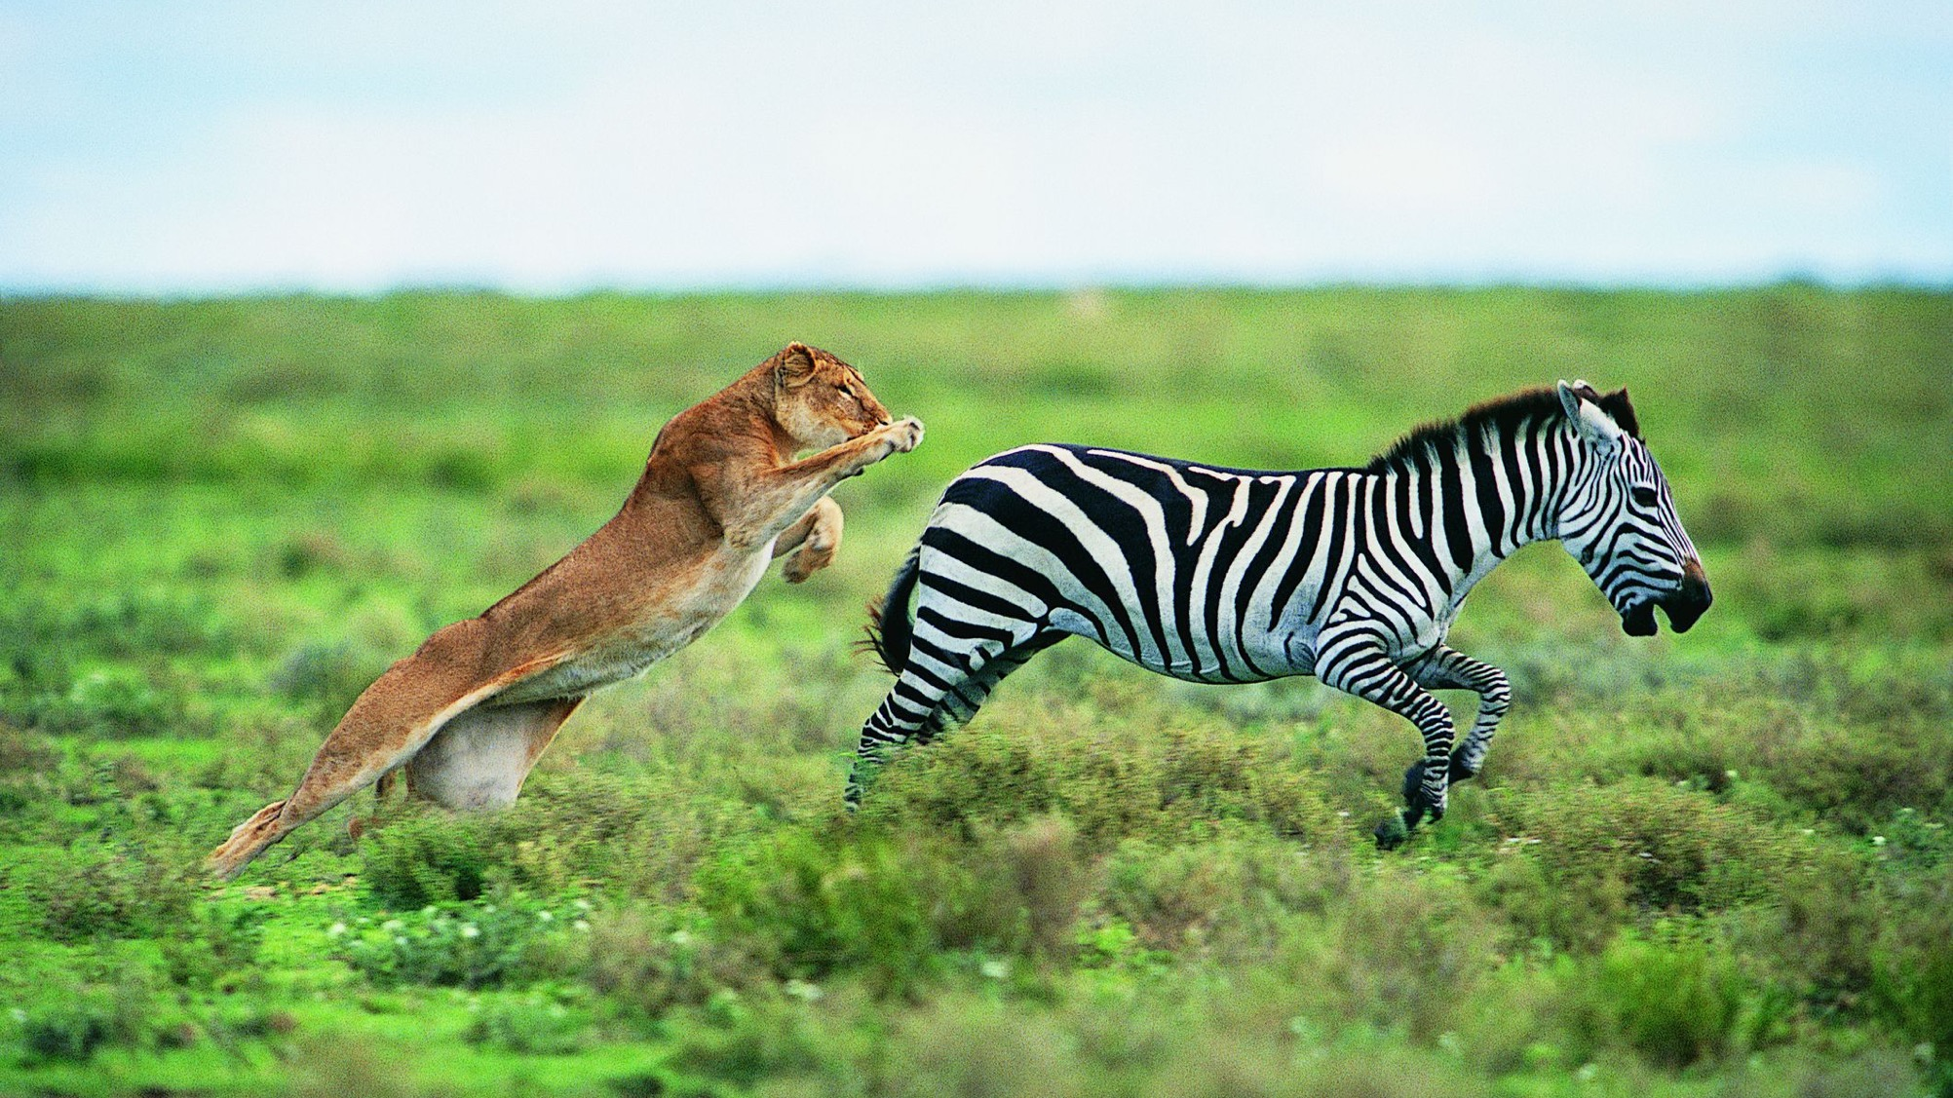
Evolution
A mechanism for change

Slide 3
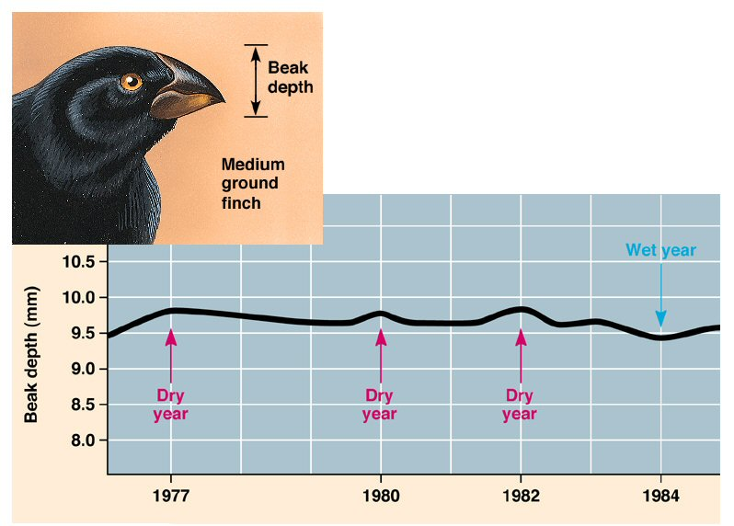
Beak size variation across time

Slide 4
How to tame a fox and build a dog

Slide 5
How to tame a fox and build a dog

Slide 6

How to tame a fox and build a dog

Slide 7
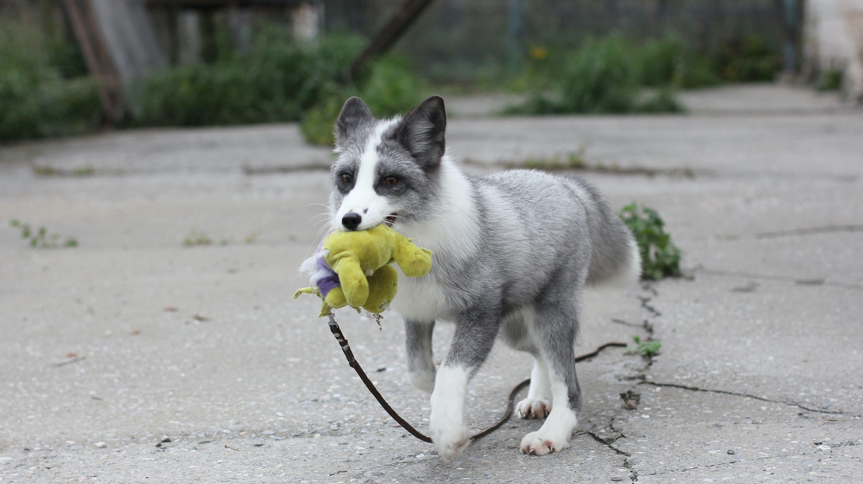
How to tame a fox and build a dog

Slide 8
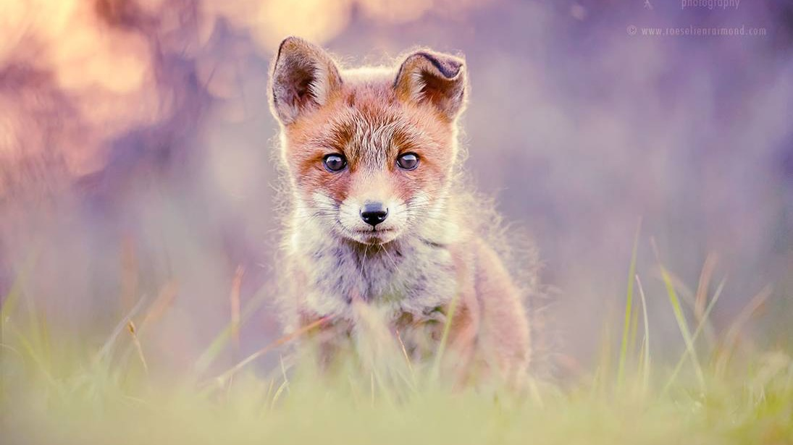
How to tame a fox and build a dog

Slide 9
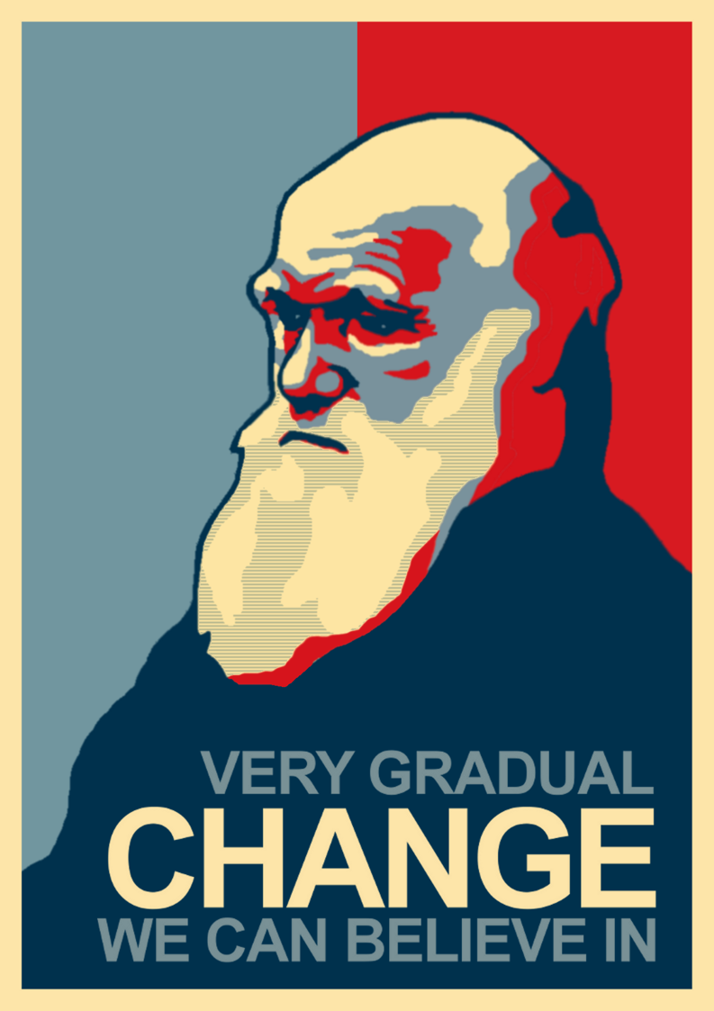
Natural Selection
A Mechanism for Change

Slide 10
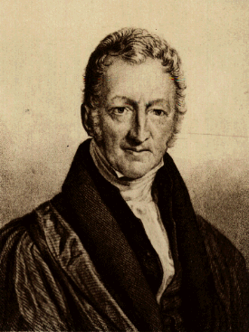
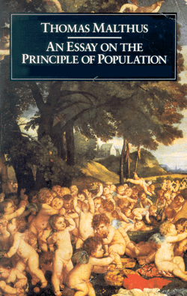
Darwin’s logic
Organisms have high reproductive potential, facilitating exponential population growth
Resources are limited
Most populations in nature are stable
Hence, there must be a fierce struggle for existence with only few progeny surviving in each generation

Slide 11
Darwin’s logic
Individuals within population exhibit enormous variability
At least some variability is heritable
Survival is not random but depends on the inherited traits (that is natural selection!)
Over generations, natural selection gives rise to gradual change of populations

Slide 12
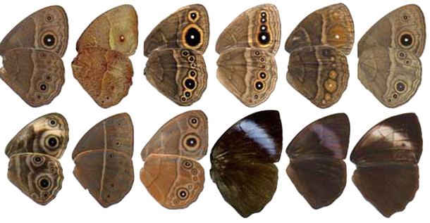
Four postulates
Individuals in a population vary in their traits.
Some of that trait variation is inherited from parents to their offspring.
More offspring are produced in every generation that can possibly survive.
Successful survival and reproduction of those offspring is not random but dependent on the traits they inherited from their parents.

Slide 13


Slide 14
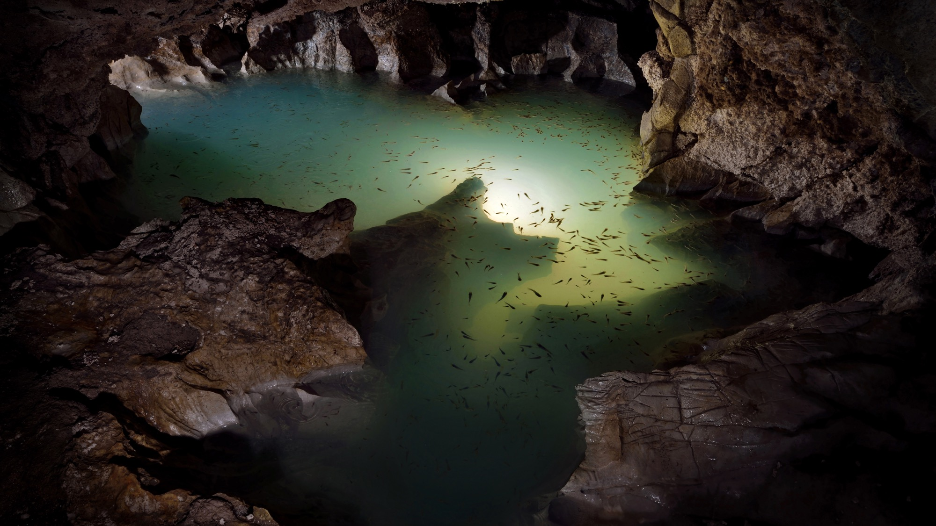

Slide 15

Using models to test hypotheses
When you can’t measure what you want to measure… use models
Measure what you can to parameterize models

Slide 16
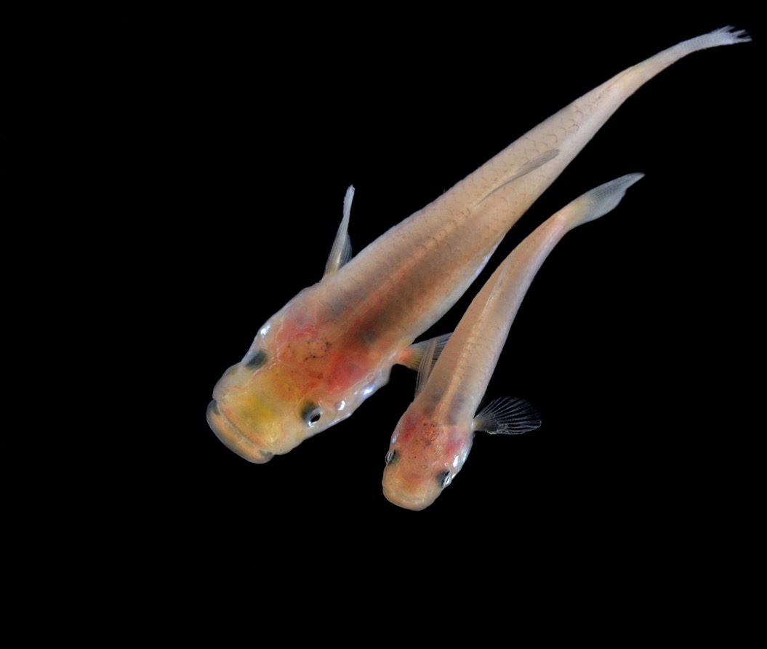
Analyzing variation
Within population variation (intrapopulation variation)
Accounting for the fact that traits scale with body size (allometry)

Slide 17
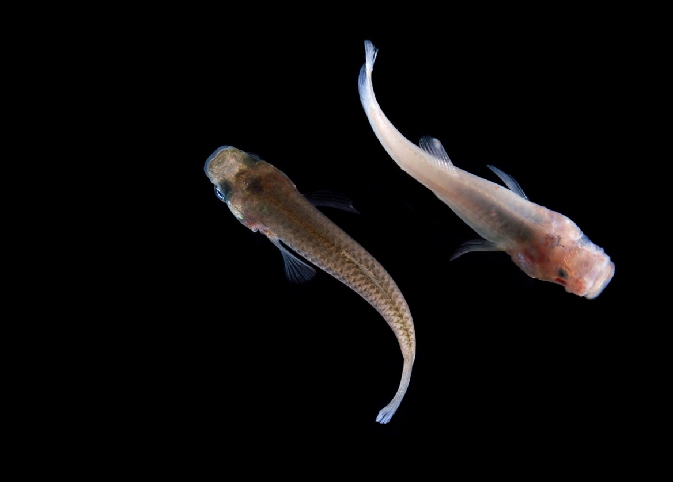
Analyzing variation
Between population variation (interpopulation variation)

Slide 18
Analyzing variation
Heritable variation

Slide 19
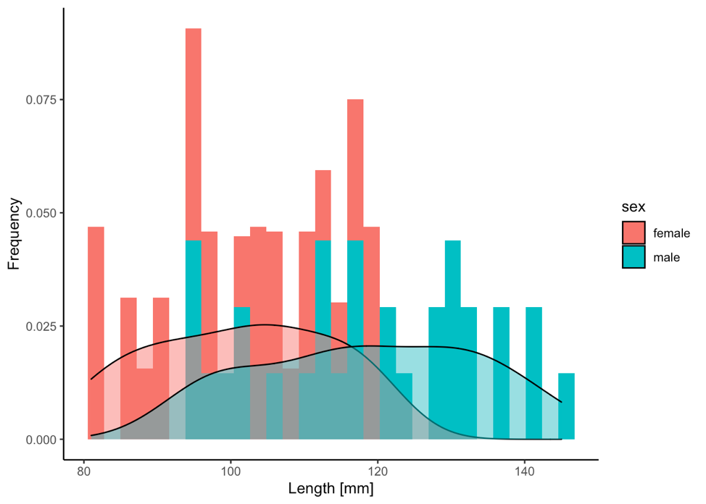
Histograms and densities
Frequency histograms allow for the comparison of trait variation among groups
Density functions are statistical representations of a trait’s distribution
Histogram and density functions can be combined into a single plot:
ggplot(data, aes(x=trait, fill=group))+
geom_histogram(aes(y=..density..))+
geom_density()

Slide 20
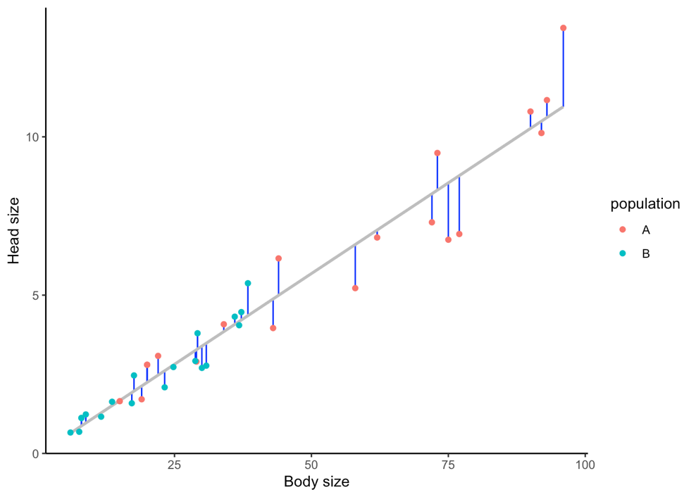
Accounting for allometry
A residual is the difference between a measured value and the predicted value
In practice, a residual is the vertical distance from a point (measurement) to the best-fit line (predicated value)
Calculating residual allows us to account for a confounding variable (body size)
Calculating residuals is a two-step process:
Calculate the best-fit line
fit <- lm(y ~ x, data = data)
Calculate the residuals
data$res <- residuals(fit)

